Slide 1

Introduction to Artificial Intelligence Group 1 Week 2
Dr. Juan Carlos Rojas
Juan-Carlos.Rojas@ttu.edu

Slide 2
Schedule
Date | Class | HW Assigned | HW Due
May 18 | Class 1 | HW1
May 25 | Class 2 | HW2 | HW1
June 1 | Class 3 | HW3 | HW2
June 8 | Class 4 | HW4 | HW3
June 15 | No class
June 22 | Class 5 | HW5 | HW4
June 29 | Class 6 | HW6 | HW5
July 6 | Class 7 | HW7 | HW6
July 13 | Class 8 |  | HW7

Slide 3
Agenda for Week 2
Theory
Regression
Linear regression
Encoding of categorical features
Development framework
Quality metrics
Multivariate linear regression
Feature scaling
Other regression methods
Classification
Quality metrics for binary classification
Classification with linear regression
Practice
Vehicle price dataset
Linear regression with 1 variable
Development framework
Multivariate linear regression
Feature scaling with Scikit-Learn
Linear regression with Scikit-Learn
Feature importance
Credit default dataset
Feature exploration
Pre-processing
Linear regression
Quality metrics
Feature importance

Slide 4
Linear Regression

Slide 5
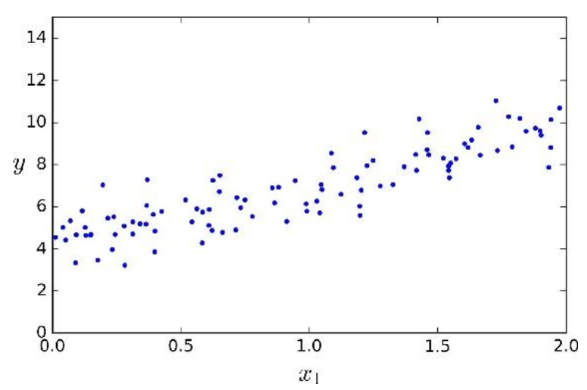
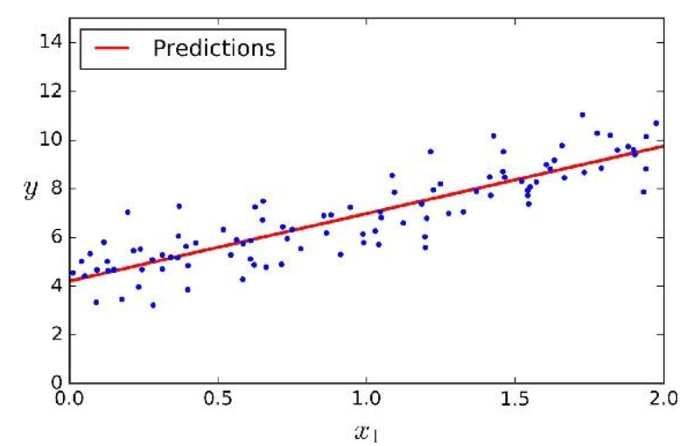
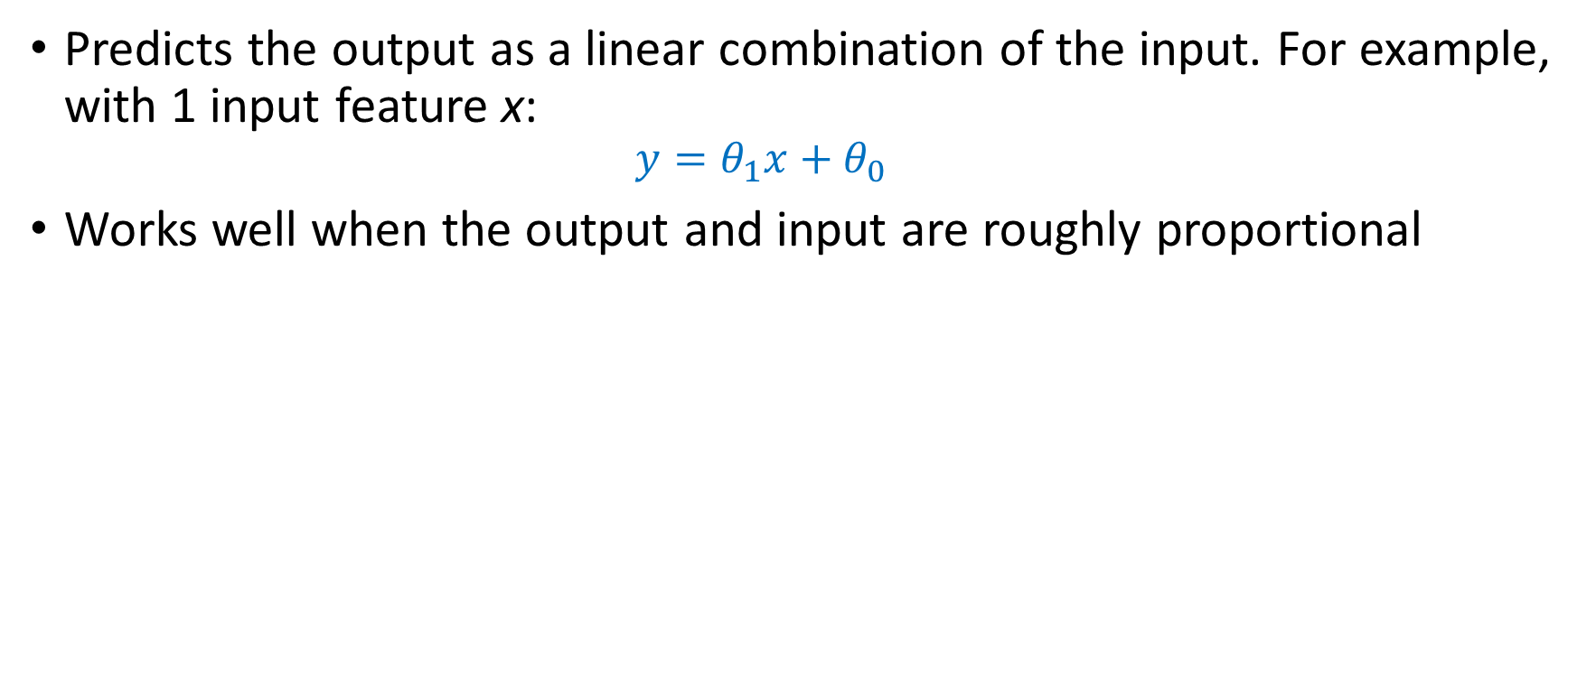
Linear Regression Model
Predicts the output as a linear combination of the input. For example, with 1 input feature x:
$$y=θ_{1}x+θ_{0}$$
Works well when the output and input are roughly proportional

Slide 6
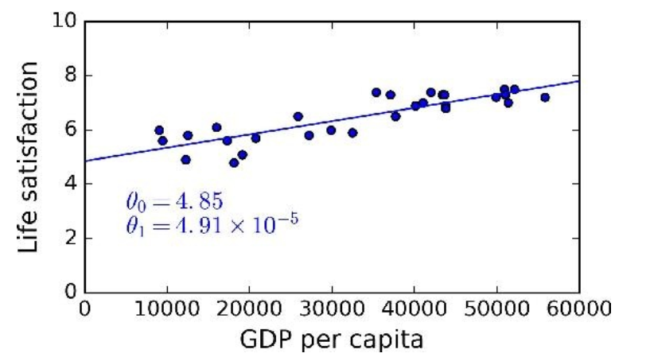
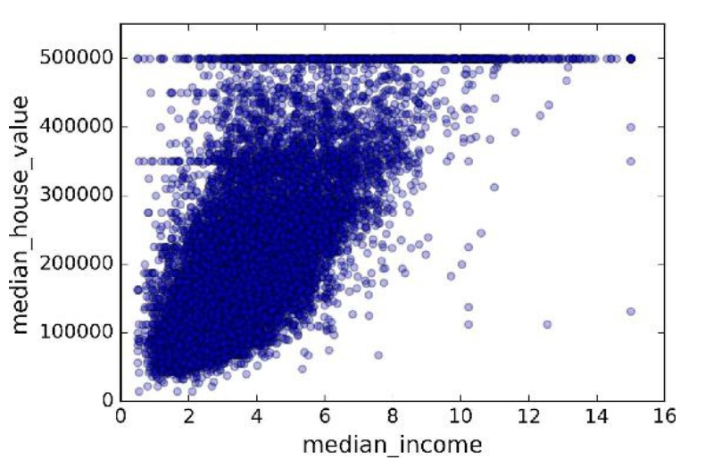
Linear Regression Examples

Slide 7
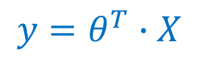
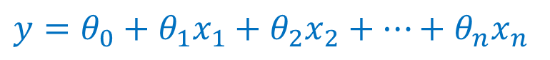
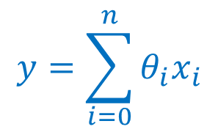
Multivariate Linear Regression
The linear regression model can be applied to multiple input features by adding more coefficients:
If you set x₀=1, then you can express it as
Or in matrix form:
$y=θ_{0}+θ_{1}x_{1}+$ $θ_{2}x_{2}+…+$ $θ_{n}x_{n}$
$$y=\sum_{i=0}^{n}{θ_{i}x_{i}}$$
$$y=θ^{T}∙X$$

Slide 8
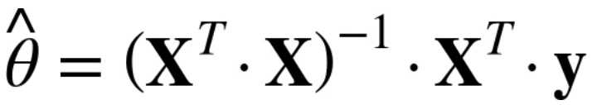
The Normal Equations
A closed-form solution for the coefficients that minimizes the mean-squared error (MSE) of the prediction w.r.t a series of observations
X is a matrix with:
One column of ones
One column per input feature
One row per data example
y is a vector with one label per example

Slide 9
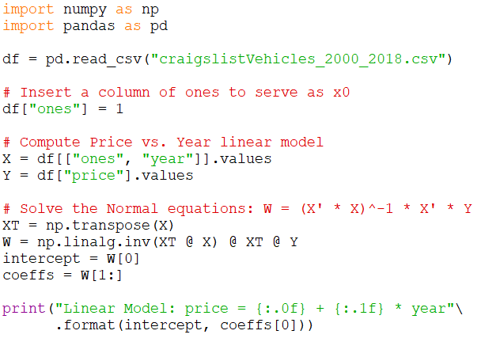
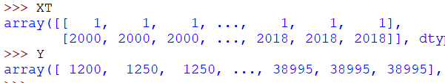
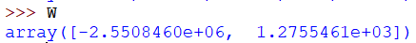
Solving the Normal Equations with NumPy Arrays
See VehiclePrice_LinearRegression_1Var_1.py

Slide 10
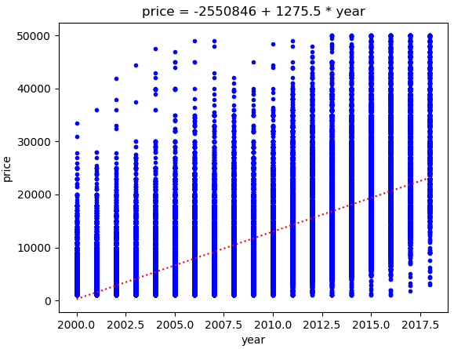
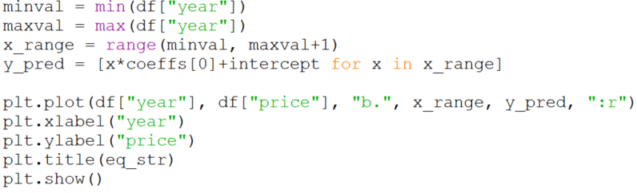
Viewing One-Variable Regression
To make sure the regression model is correct, we can plot the trendline over the scatterplot
See VehiclePrice_LinearRegression_1Var_2.py

Slide 11
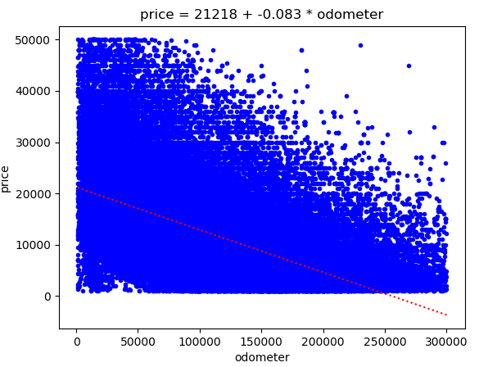
Practice 1
Solve the Normal Equations to compute a linear-fit model for price vs. odometer of the form: y = m*x + b, where x is the vector of odometer values, and y is the vector of prices.
m should be a single coefficient
b should be a single value for the intersection
Plot the scatterplot of price vs. odometer, with the best fit trendline on top

Slide 12
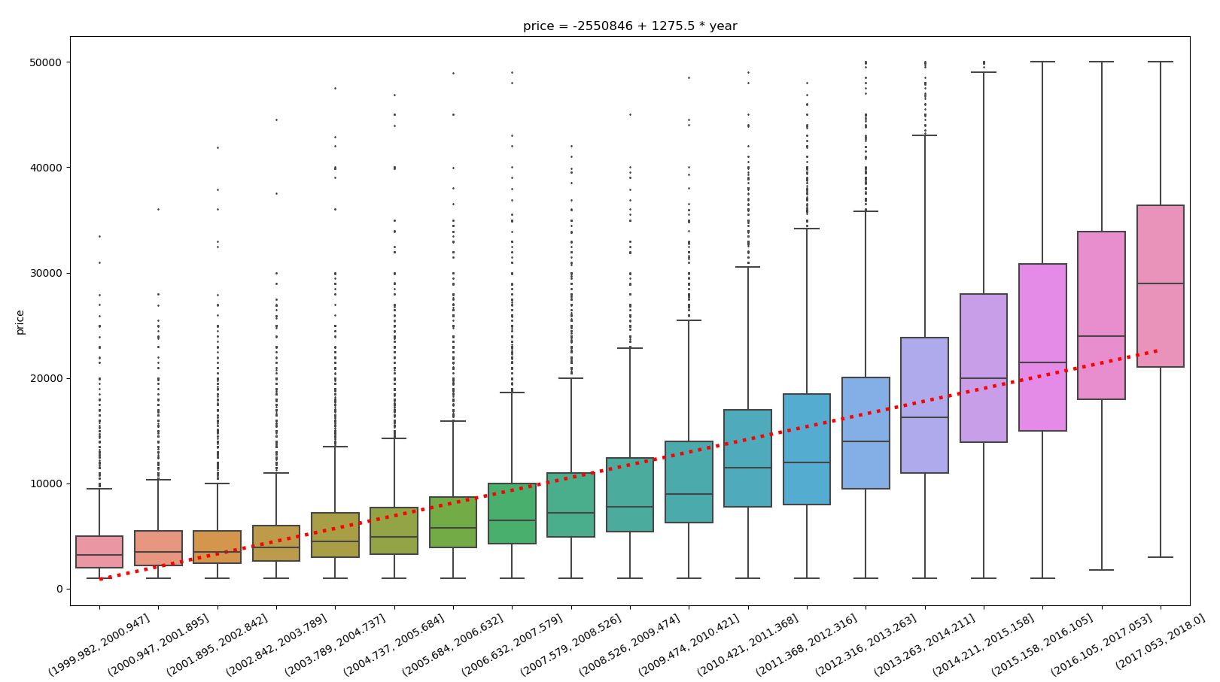
Extra Challenge
Plot the trendline on top of a boxplot
Hint: need to manipulate the x values to align (they have a different scale)

Slide 13
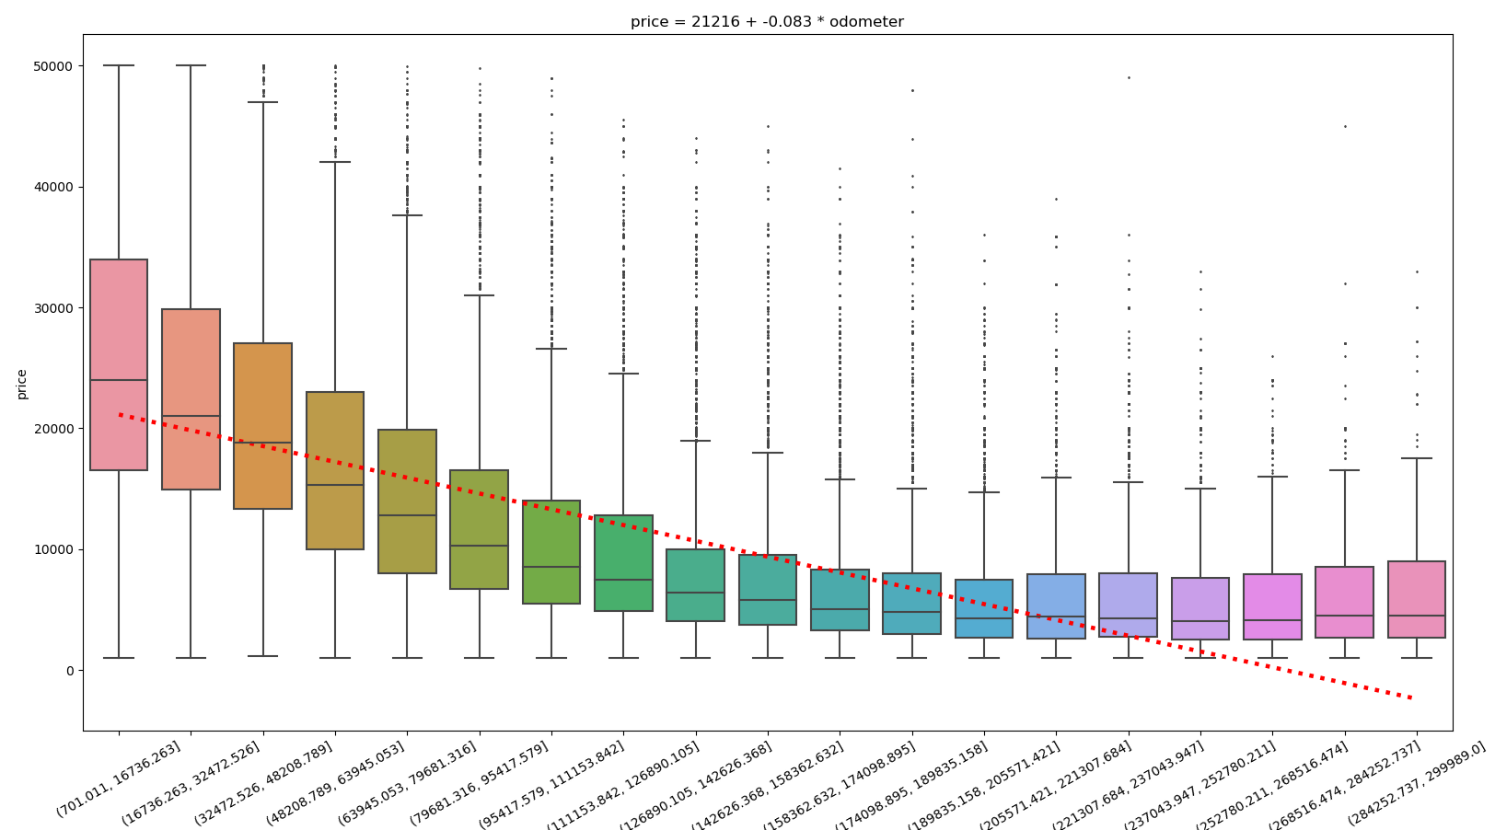
Price vs. Odometer
See VehiclePrice_LinearRegression_1Var_3.py

Slide 14
Encoding Categorical Features
In order to use categorical features as inputs to a mathematical model like linear regression, they must be encoded as numbers
This is called Label Encoding
But these categories don’t necessary have an order, or relate to each other in a numerical way
Simply assigning numbers would create a false scale and order
Instead we need to expand into additional helper “dummy” variables
One per class -1 (will explain soon)
Encoded as 1 or 0 (known as “one-hot” encoding)

Slide 15
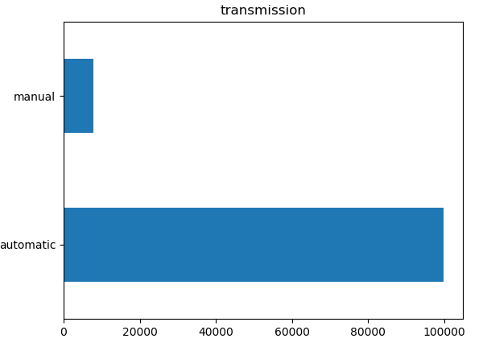
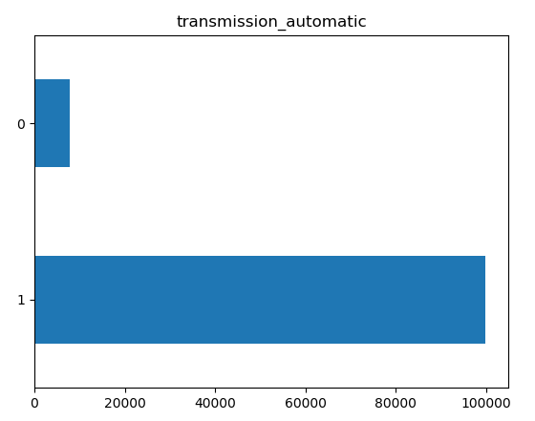
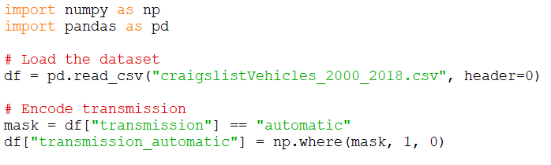
Encoding Example 1
Consider the “transmission” feature in the vehicle price dataset
There are two classes: manual & automatic
In this case, since there are only 2 categories, we can simply rename “manual” to 0 and “automatic” to 1

Slide 16
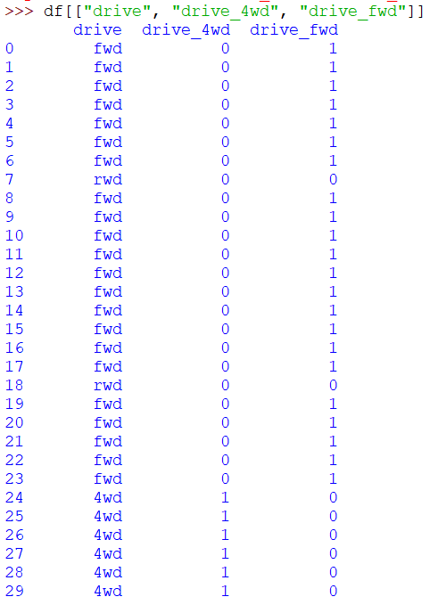
Encoding Example 2
Now consider the “drive” feature
It has 3 classes: rwd, fwd and 4wd
We need 2 helper “dummy” columns:
Pick any 2
“drive_4wd”: 1 if 4wd, 0 otherwise
“drive_fwd”: 1 if fwd, 0 otherwise
No need for “drive_rwd”
It is redundant, can be derived from the others
Provides no new information
Worsens prediction models if left in
See VehiclePrice_EncodeCategorical_2.py

Slide 17
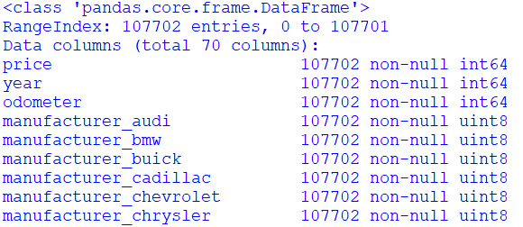
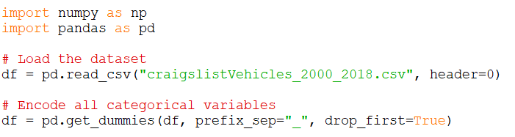
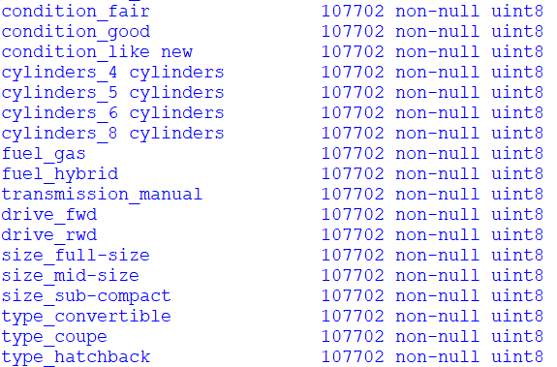
Encoding Categorical Features in Pandas
Pandas can do all the categorical encoding with one simple command:
See VehiclePrice_EncodeCategorical_3.py

Slide 18
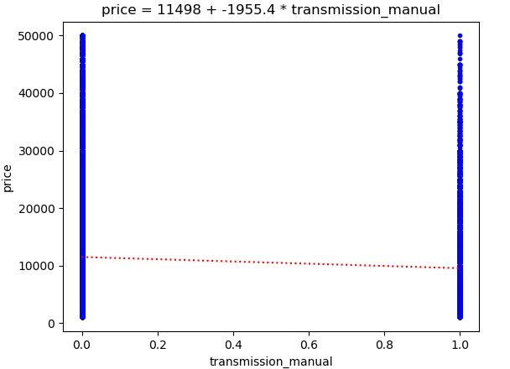
Linear Regression w.r.t. Categorical Features
Now that the categorical features have been label and one-hot encoded, we can use them as inputs to a linear regression model
See VehiclePrice_LinearRegression_1Var_4.py

Slide 19
Practice 2
Use Pandas to label-encode and one-hot encode all categorical features in the vehicle price dataset
Pick any one of the new dummy variables
Compute a linear regression model of price vs. your variable
Plot the distribution of price vs. your variable, and plot your best-fit equation on top

Slide 20
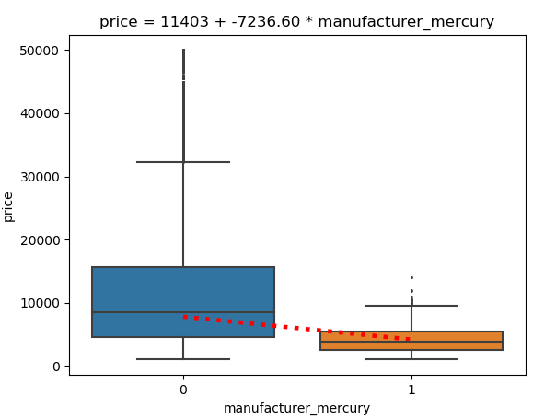
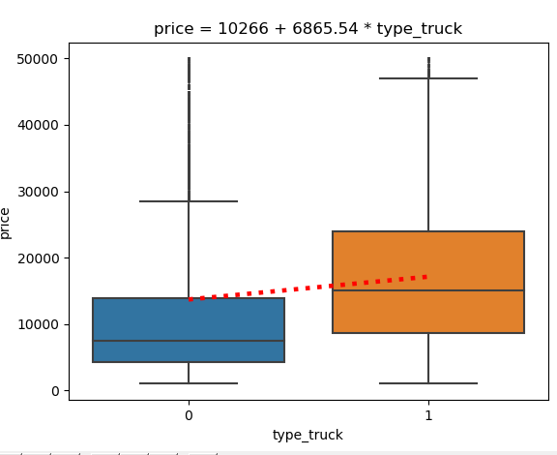
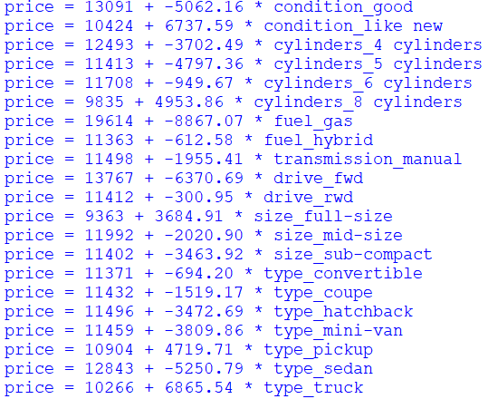
Extra Challenge
We can automatically generate these models and plots for all variables
It would be nice to show them on top of box plots
See VehiclePrice_LinearRegression_1Var_5.py

Slide 21
Framework for Developing Machine Learning

Slide 22
Development Framework Needs
We need a fair way to test out prediction results
Independent from training data
Representative of problem
A quality metric
Repeatability

Slide 23
Machine Learning Dev. Framework
Training Data
ML Algorithm
Training Labels
Model
Inference Engine
Test Data
Label Predictions
Quality Estimation
Test Labels
Quality Metrics

Slide 24
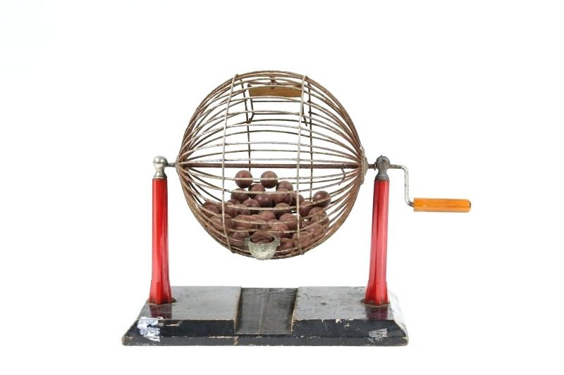

Splitting the Available Data
Shuffle the data randomly
Split 80/20
Save for later
Training Data
Test Data

Slide 25
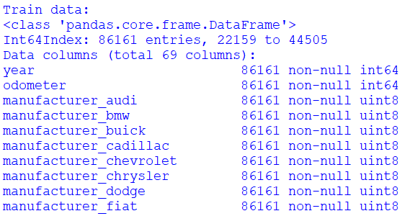
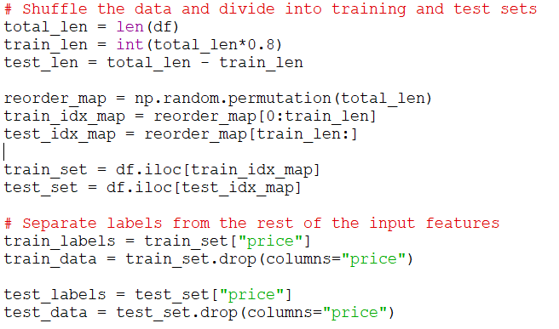
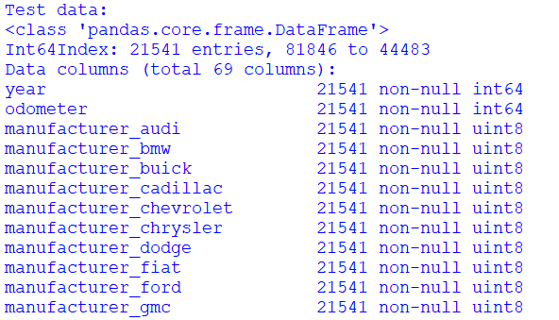
Splitting Data in Pandas
See VehiclePrice_PrepareDataset.py

Slide 26
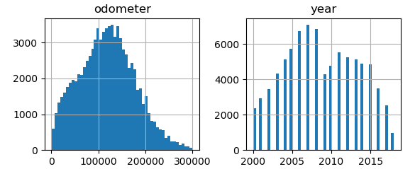
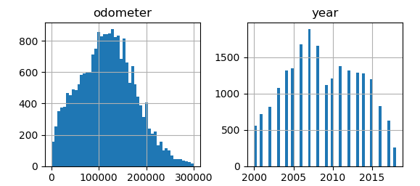
Verifying the Split
We can plot histograms of a few features to make sure the split data sets are consistent
See VehiclePrice_PrepareDataset.py

Slide 27
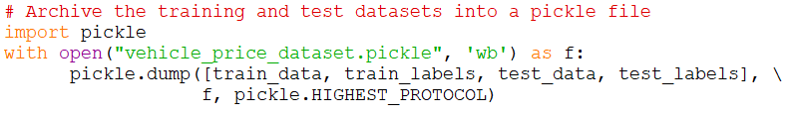
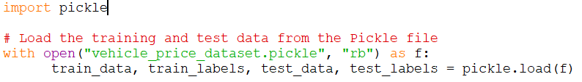
Saving the Split Data
It is a good idea to save the datasets at this point
This will provide a consistent input for future experiments
Loading the Pickle Data
See VehiclePrice_PrepareDataset.py

Slide 28
Practice 3
Load the vehicle price dataset pickle file (vehicle_price_dataset.pickle)
Verify that the columns and rows of train_data and test_data are consistent with expectations
Print the length of the train_labels and test_labels
Make sure these are also consistent
Plot histograms of the year and odometer columns of the train_data and test_data
Make sure they are consistent with expectations

Slide 29
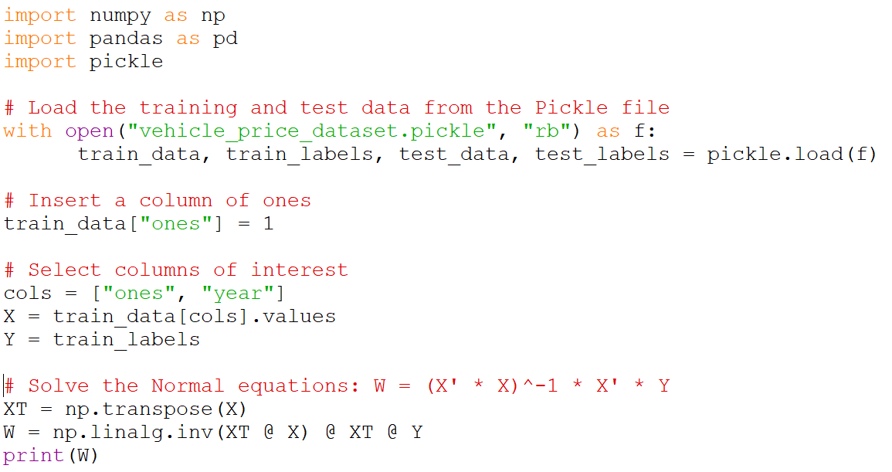
Training the Model
We will train a linear regression model against one input feature, using the train data and labels
Training Data
ML Algorithm
Training Labels
Model
Inference Engine
Test Data
Label Predictions
Quality Estimation
Test Labels
Quality Metrics
See VehiclePrice_LinearRegression_1Var_6.py

Slide 30
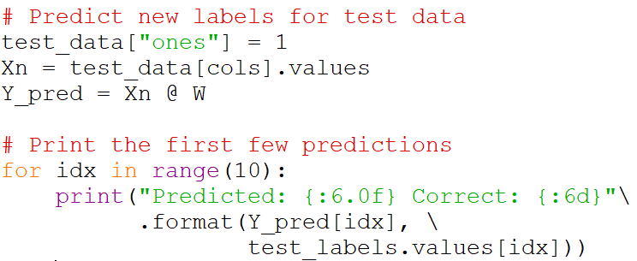
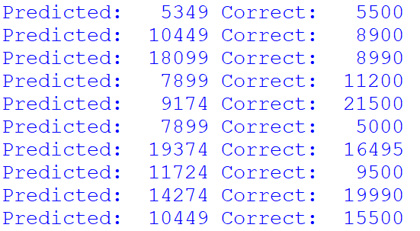
Predicting new Labels
Now we can use the trained model to predict labels for the test data
Training Data
ML Algorithm
Training Labels
Model
Inference Engine
Test Data
Label Predictions
Quality Estimation
Test Labels
Quality Metrics
See VehiclePrice_LinearRegression_1Var_6.py

Slide 31
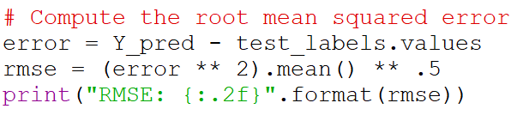
Assessing the Prediction Quality
We compare the predicted labels with the correct labels and compute a quality metric
The most common measure is the mean squared error (RMSE)
Training Data
ML Algorithm
Training Labels
Model
Inference Engine
Test Data
Label Predictions
Quality Estimation
Test Labels
Quality Metrics
See VehiclePrice_LinearRegression_1Var_6.py

Slide 32
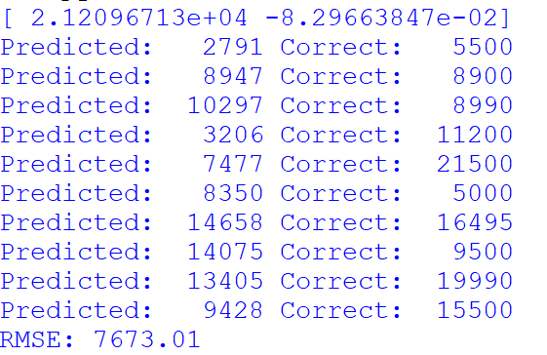
Practice 4
Load the vehicle price dataset pickle file (vehicle_price_dataset.pickle)
Train a linear prediction model against the odometer feature
Predict new labels for the test data
Compute the RMSE of your predictions against the true labels

Slide 33
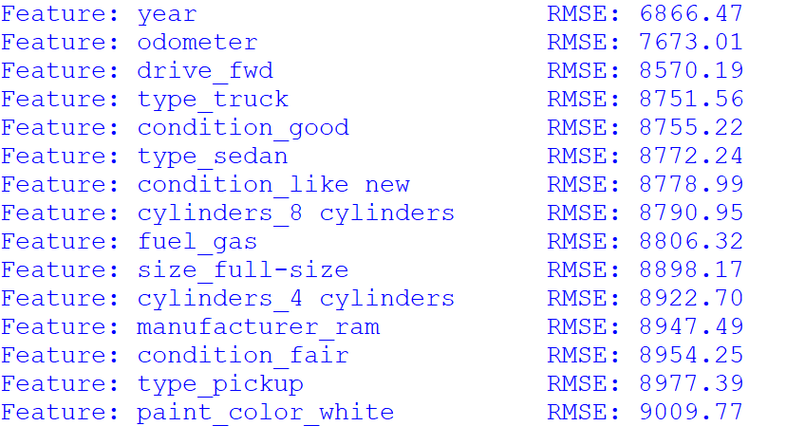
Extra Challenge
Try linear regression against each available feature, and compare the RMSEs
Sort the features by RMSE
See VehiclePrice_LinearRegression_1Var_7.py

Slide 34

Break

Slide 35
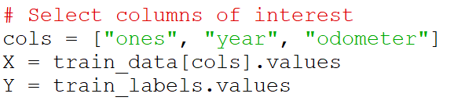
Multivariate Linear Regression
We can add more features to our model simply by adding columns to X
Let’s try with 2 input features: year and odometer

Slide 36
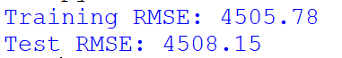
Practice 5
Load the vehicle price dataset pickle file (vehicle_price_dataset.pickle)
Train a linear prediction model against all the available features
Predict new labels for the test data
Compute the RMSE of your predictions against the true labels
Predict new labels for the training data
Compute the RMSE of your predictions against the true labels

Slide 37
Underfitting & Overfitting
Overfitting:
If the model is memorizing the training data
Does not generalize well to new test data
Training accuracy is much higher than test accuracy
Underfitting:
If the model is over-simplified
Does not represent all the complexity in the data
Generalizes well to new test data
Training and test accuracy are similar

Slide 38
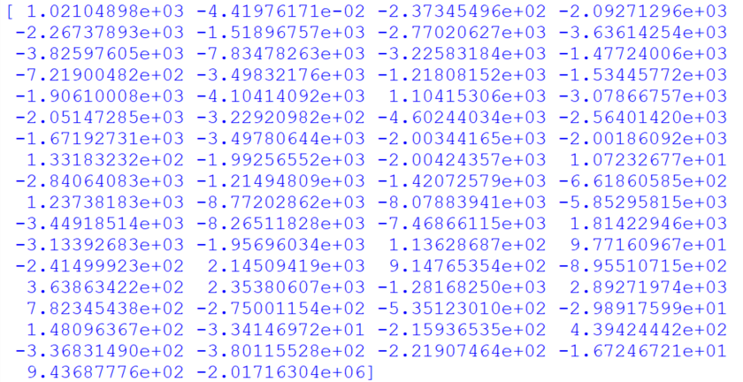
Analyzing the Model Coefficients
We should be able to use the linear model coefficients as a measure of feature importance
But the features are in different scales, which makes the coefficients difficult to compare
Need to standardize the scale of the input data

Slide 39
Feature Scaling
It is recommended that we don’t just normalize the scale of the input features, but standardize their distributions
Scale and offset so that the distribution has a mean of 0 and variance of 1.0
This is necessary for correct operation of some algorithms
It is also helpful for comparing feature importance
i.e. comparing linear regression coefficients

Slide 40

Scikit-Learn
A rich library for machine learning
Regression, classification, clustering
Contains many “classic” algorithms
Also has libraries for pre-processing & quality metrics
Maintains a similar interface for most algorithms

Slide 41
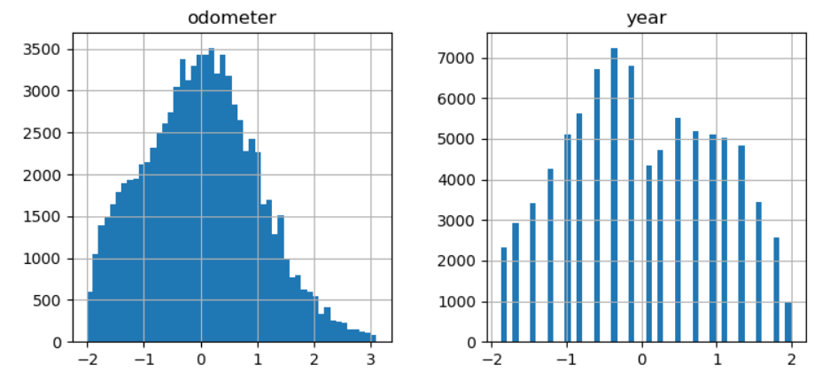
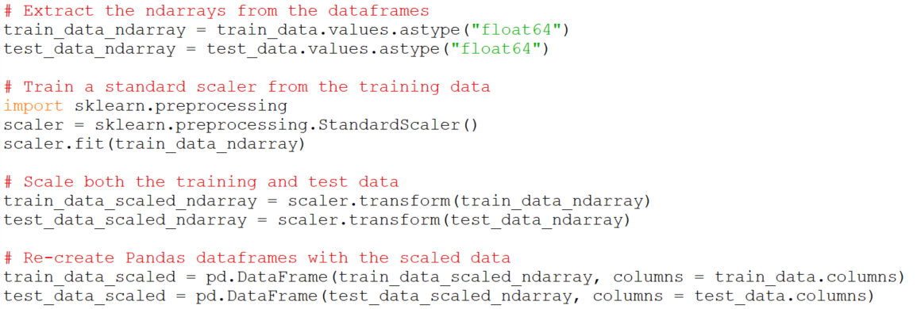
Feature Scaling with Scikit-Learn
We train a StandardScaler in sklearn, and apply it to both the training and the test data sets
Save it into a new Pickle file
See VehiclePrice_ScaleDataset.py.py

Slide 42
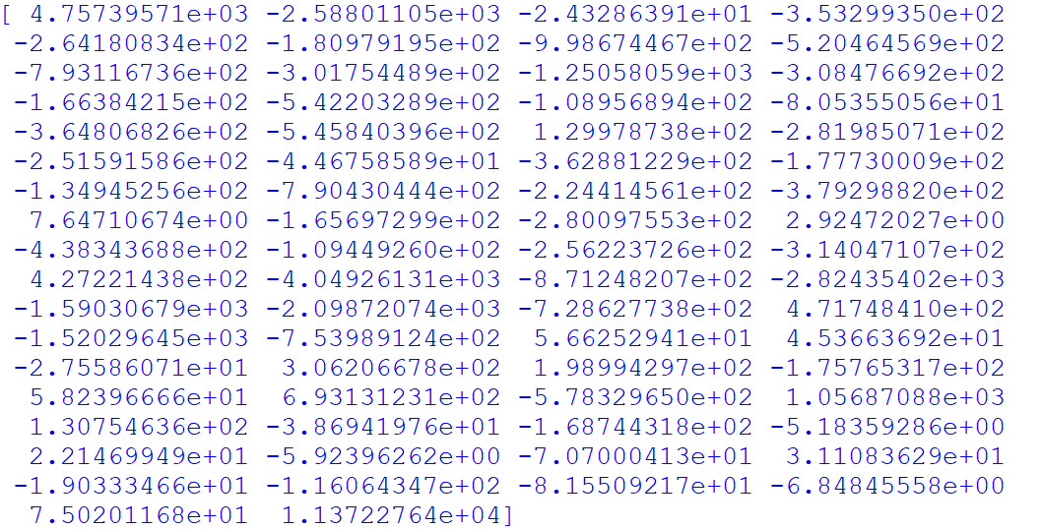
Feature Importance
New that we have the scaled dataset, we can use it to train a linear model and compare the coefficients
See VehiclePrice_LinearRegression_Multivar_2.py

Slide 43
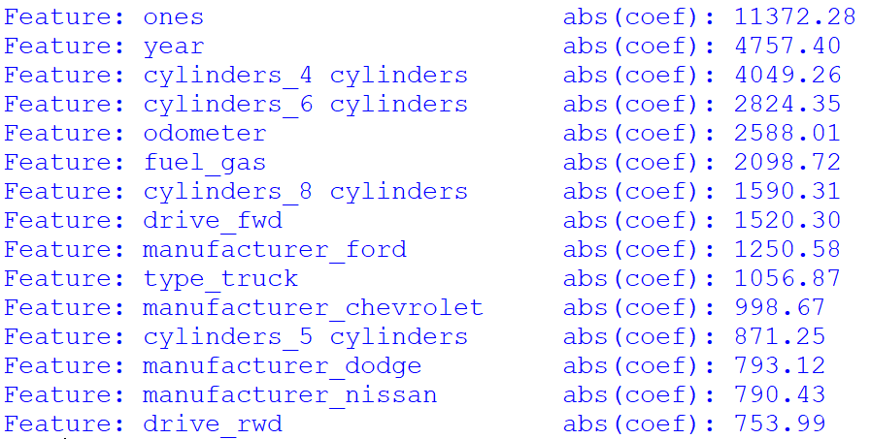
Feature Importance
We can compute the absolute value of the coefficients and sort them
The ones with the highest coefficients are the more important features for this model
See VehiclePrice_LinearRegression_Multivar_2.py

Slide 44
Feature Importance
Contrasting with the RMSE study, we see some coincidences
But not always
Cross-correlations matter

Slide 45
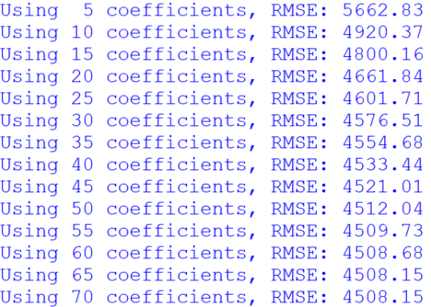
Feature Pruning
We can get rid of the features that have least effect on the model
How many?
What effect will it have on the RMSE?
We can re-train the linear model with the top N coefficients of the sorted list
Compute the RMSE
Repeat with different N
See VehiclePrice_LinearRegression_Multivar_3.py

Slide 46


Linear Regression with Scikit-Learn
See VehiclePrice_LinearRegression_Multivar_4.py

Slide 47

Polynomial Regression
It is possible to extend linear regression to quadratic and higher order relationships
New derived features are computed for x_{i}² and cross terms
It is still a linear regression problem
There is one weight per feature
Still has closed-form solutions (Normal equations)
In Scikit-Learn:
sklearn.preprocessing.PolynomialFeatures
$y=θ_{0}+θ_{1}x_{1}+$ $θ_{2}x_{1}^{2}+θ_{3}{x_{1}x}_{2}+θ_{4}x_{2}+ θ_{5}x_{2}^{2}+…$

Slide 48

Other Regression Methods
K-Nearest Neighbors
Partial Least Squares
Support Vector Regression
Decision Tree Regression
Neural Networks

Slide 49
Classification

Slide 50

Binary Classification
Organize into two buckets

Slide 51
Credit Default Database
Database of credit card default situations in Taiwan in 2005
Based of https://archive.ics.uci.edu/ml/datasets/default+of+credit+card+clients
Cleaned-up by JCR
Replaced numbers by labels in categorical columns (education, marriage, etc.)
Added unpaid amounts
23 input features
Age, education, marriage, sex, credit limit
Current bill
Last 5 bill amounts
Last 5 payments
Last 5 unpaid amounts (derived from above)
Binary output feature
Will default on payment next month? (yes/no)
30,000 cases

Slide 52

Dataframe Info

Slide 53






Input Data Distributions
See CreditDefault_ExploreFeatures_1.py

Slide 54

Output Data Distribution
The output labels are unbalanced
Deserves care when configuring models and analyzing results

Slide 55



Individual Feature Relationships to Output
Since the output feature is categorical, bar-plots make more sense
Default rate by category
This is very easy with Seaborn bar-plots
See CreditDefault_ExploreFeatures_2.py

Slide 56


Pre-Process
As usual, we need to:
Encode categorical features
Shuffle the data
Split into training and test
Separate the output labels
Standardize the scale
Save
See CreditDefault_PrepareDataset.py

Slide 57
Classification with Linear Regression
We can train a linear regressor for the credit default, as before
This will produce a prediction number that is continuous between 0 and 1
It can be interpreted as a prediction probability of being a credit default

Slide 58

Practice 6
Load the credit default dataset pickle file (credit_card_default_dataset.pickle)
Train a linear prediction model against all the available features
Predict new labels for the test data
Print the first 20 predictions, and also the first 20 correct labels

Slide 59

Binary Classification with Linear Regression
The prediction probabilities need to be compared to a threshold to decide if they are going to be classified as 1 or 0
For most problems, a threshold of 0.5 makes sense:
See CreditDefault_LinearRegression_2.py

Slide 60


Binary Classification with Linear Regression
With a threshold of 0.5:
No predictions of 1 were made!
This situation can happen in unbalanced class problems like this one
Let’s try lowering the threshold:
The more we lower the threshold, the more 1s we will predict
What is the correct threshold to use?

Slide 61
The Confusion Matrix
Provides a complete picture of classification results
 |  | Predicted Label
 |  | False | True
Correct Label | False | True Negatives (TN) | False Positives (FP)
 | True | False Negatives (FN) | True Positives (TP)

Slide 62



The Confusion Matrix
In scikit-learn:

Slide 63





Accuracy
Can be misleading in class-imbalanced cases:

Slide 64


Precision & Recall
Precision:
Out of all the positive predictions, how many are actually correct?
Recall:
Out of all the actual positives, how many did we correctly predict?
The classification threshold will trade-off precision vs. recall

Slide 65





Precision & Recall
The classification threshold will trade-off precision vs. recall
See CreditDefault_LinearRegression_2.py

Slide 66


Precision – Recall Graph
We can clearly see the tradeoff between precision & recall
We can choose a classification threshold that meets our needs

Slide 67


Receiver Operating Characteristic (ROC)
Comparison of true positive rate with false positive rate
The area under the curve (AUC) provides a measure of classifier quality
See CreditDefault_LinearRegression_3.py

Slide 68


Overfitting / Underfitting
As before, we compute the quality metrics against the test data and the training data
The scores are similar, which suggests the model is underfitting the data
See CreditDefault_LinearRegression_3.py

Slide 69

Feature Importance
As before, we use the absolute value of the coefficients to infer feature importance
See CreditDefault_LinearRegression_4.py

Slide 70
Thank you

